Slide 1
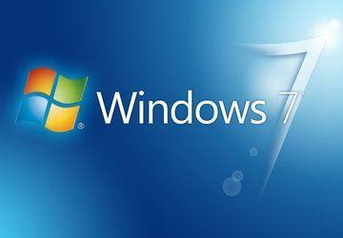
Purchase a Genuine License Key for Windows 7 Home Premium for One PC with Fast Delivery By Keys-shop
The best operating system for consumers looking for a recognizable, reliable, and easy-to-use interface is Buy Windows 7 Home Premium 1Pc. This edition provides
critical features like Windows Media Center, Aero themes, and better performance—all tailored for home use whether you're recovering a PC or updating an outdated system.
⚡ Immediate Digital Delivery: Keys-shop makes it simple to begin going. Your Windows 7 Home Premium license key is sent to you via email immediately after purchase. Your system will be operational in no time thanks to simple activation procedures; a physical delivery is not required.
⚡ Reliable Tools & Efficient Performance: Take advantage of the dependability of one of Microsoft's most widely used operating systems. Windows 7 Home Premium is ideal for families, students, and casual users who appreciate efficiency and simplicity because it supports multitasking, home networking, and fluid media playback.
⚡ One-Time Activation for Lifetime Use: This license key is good for one PC's lifetime of use and activates Windows 7 Home Premium on that particular computer. There are no additional costs; it's a one-time purchase. Additionally, Keys-shop provides knowledgeable assistance to help with activation or installation.

Slide 2
⚡ Keys-shop: Why Choose It?
Completely authentic Microsoft license
Instant Delivery of Emails
Competitive Rates
Reliable Customer Service
Purchase your Windows 7 Home Premium license from Keys-shop right now and start using your computer in a dependable, comfortable and familiar manner. For more visit us!

