Slide 1
Chapter three
Cost of capital

Slide 2
Types of capital firm’s use.
Debt
preferred stock.
The third type of capital, common equity, is provided by the company’s common stockholders, and it is raised in two ways: (1) by issuing new common stock and (2) by retaining earnings (that is, by not paying out all of their earnings as dividends). Equity raised by selling newly issued stock is called external equity, while retained earnings are called internal equity
A firm’s overall cost of capital is an average of the costs of the various types of funds it uses.

Slide 3
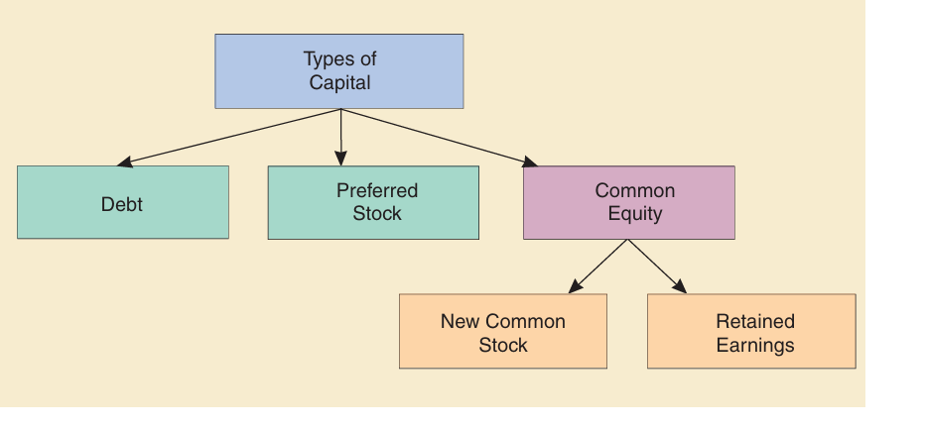
Types of capital

Slide 4
Capital Component: One of the types of capital used by firms to raise funds
rd =interest rate on the firm’s new debt =before-tax component cost of debt.
rd (1 -T) =after-tax component cost of debt, where T is the firm’s marginal tax rate.
Rd (1 -T) is the debt cost used to calculate the weighted average cost of capital. The after-tax cost of debt is lower than the before-tax cost because interest is deductible for tax purposes.
r p =component cost of preferred stock. Preferred dividends are not deductible, hence the before and after-tax costs of preferred are equal.
r s =component cost of common equity raised by retaining earnings, or internal equity.
r e =component cost of external equity, or common equity raised by issuing new stock.

Slide 5
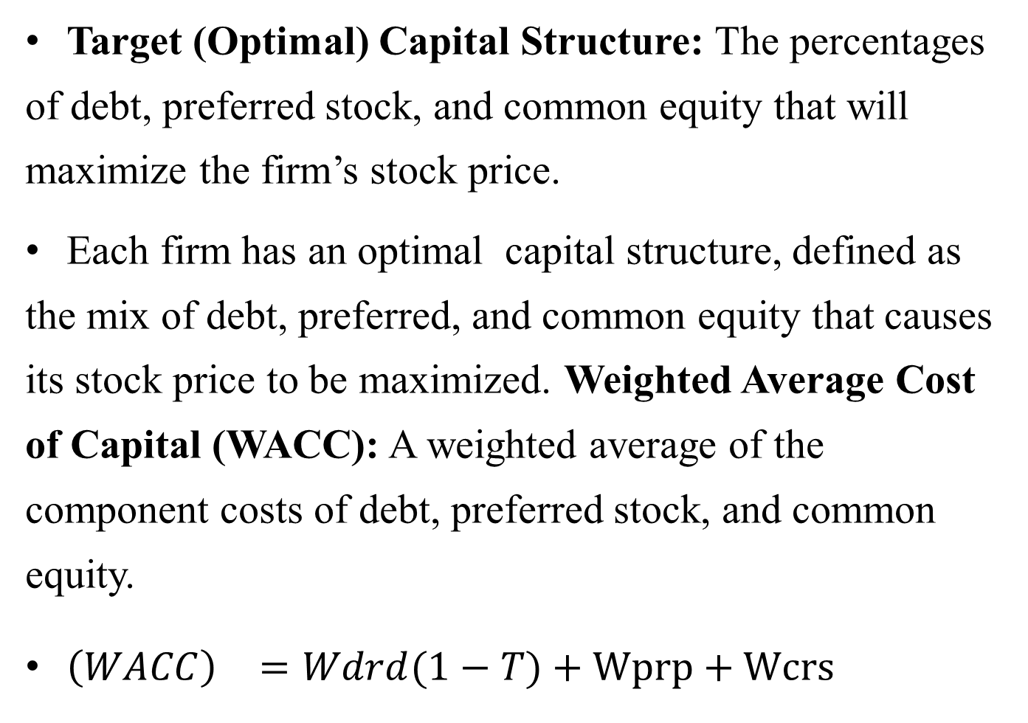
Target (Optimal) Capital Structure: The percentages of debt, preferred stock, and common equity that will maximize the firm’s stock price.
Each firm has an optimal capital structure, defined as the mix of debt, preferred, and common equity that causes its stock price to be maximized. Weighted Average Cost of Capital (WACC): A weighted average of the component costs of debt, preferred stock, and common equity.
${\left(WACC\right)}^{}=Wdrd(1−T)+Wprp+Wcrs$

Slide 6
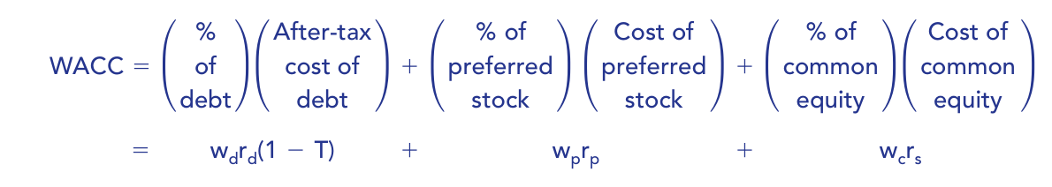
Weighted Average Cost of Capital (WACC)

Slide 7
After-Tax Cost of Debt, r d(1 -T): The relevant cost of new debt, taking into account the tax deductibility of interest; used to calculate the WACC.
After-tax cost of debt=Interest rate -Tax savings
Why is the after-tax cost of debt rather than the before-tax cost used to calculate the WACC?
Because we are interested in maximizing the value of the firm’s stock, and the stock price depends on after-tax cash flows, and because cash flows and rates of return should be calculated on a comparable basis, we adjust the interest rate downward to take account of debt’s preferential tax treatment.

Slide 8
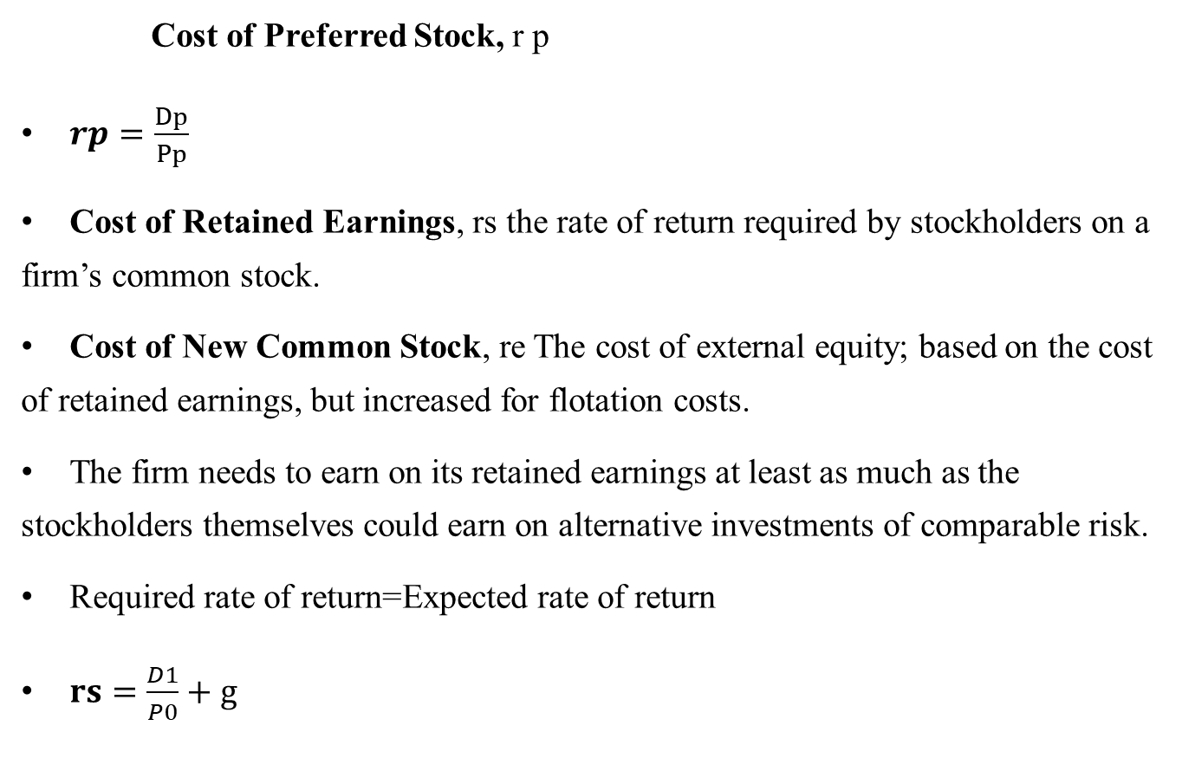
    Cost of Preferred Stock, r p
$rp=\frac{Dp}{Pp}$
Cost of Retained Earnings, rs the rate of return required by stockholders on a firm’s common stock.
Cost of New Common Stock, re The cost of external equity; based on the cost of retained earnings, but increased for flotation costs.
The firm needs to earn on its retained earnings at least as much as the stockholders themselves could earn on alternative investments of comparable risk.
Required rate of return=Expected rate of return
$rs=\frac{D1}{P0}+g$

Slide 9
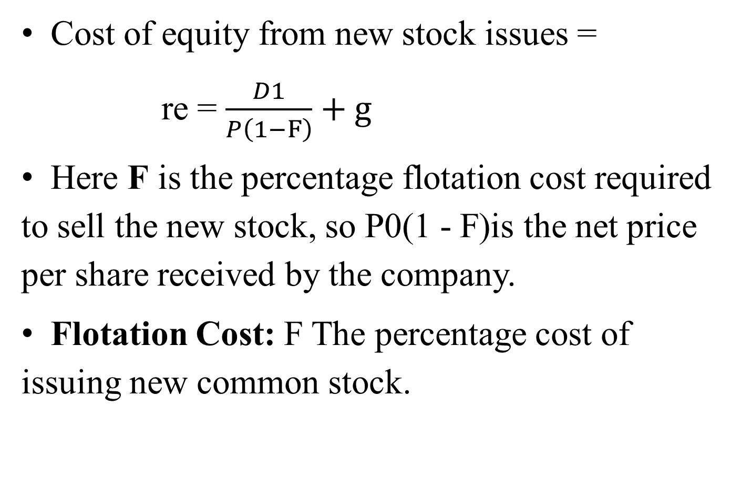
Cost of equity from new stock issues =
re = $\frac{D1}{P\left(1−F\right)}+g$
Here F is the percentage flotation cost required to sell the new stock, so P0(1 - F)is the net price per share received by the company.
Flotation Cost: F The percentage cost of issuing new common stock.

Slide 10

Cost of Retained Earnings, rs The rate of return required by stockholders on a firm’s common stock.
Cost of New Common Stock, re The cost of external equity; based on the cost of retained earnings, but increased for flotation costs
if a stock is in equilibrium, its required rate of return, rs, must be equal to its expected rate of return, rˆs. Further, its required return is equal to a risk-free rate, rRF, plus a risk premium, RP, whereas the expected return on the stock is its dividend yield, D1/P0, plus its expected growth rate, g. Thus, we can write out the following equation and then estimate rs using the left or the right term, or both:

Slide 11
Another method for estimating g involves first forecasting the firm’s average future dividend payout ratio and its complement, the retention rate, and then multiplying the retention rate by the company’s average expected future rate of return on equity (ROE):

Slide 12
Factors that affect WACC
Factors the Firm Cannot Control
The two most important factors that are beyond a firm’s direct control are interest rates and tax rates. If interest rates in the economy rise, the cost of debt increases because firms will have to pay bondholders more when they borrow.
Tax rates are used in the calculation of the component cost of debt and thus they have an important effect on the cost of capital.
Taxes also affect the cost of capital in other less apparent ways. For example, the recent lowering of tax rates on dividends and capital gains relative to rates on interest income makes stocks relatively attractive, and that reduces the relative cost of equity and thus the WACC.

Slide 13
Factors the Firm Can Control
A firm can directly affect its cost of capital in three primary ways:
by changing its capital structure.
by changing its dividend payout.
by altering its capital budgeting decision rules to accept projects with more or less risk than in the past.

